Slide 1

Final Acceptance Review: Active Elbow Orthosis
Team: Michael Sveiven, Adriana Barreda, Blakeley Koziol, Timmy Shimon, Justin Hsieh, Carissa Grijalva
Sponsor: Dr. Dan Latt, Department of Orthopaedic Surgery

Slide 2
Contents Points
1.0 Introduction (5)
2.0 Changes Since CDR (Class 1) (10)
3.0 FAT results (25)
4.0 Deliverables and Close-out plan (15)
5.0 Budget (15)
6.0 Lessons Learned (15)
7.0 Summary (5)
8.0 Ability to Communicate Effectively (5)
9.0 Application of Appropriate Engineering Standards (5)
Notes:
Delete this slide before the presentation

Slide 3
Introduction
The goal of this project is to design and create a motor-hinged elbow orthosis activated by an iOS application that will maintain as much range of motion in the joint during the healing process while simultaneously breaking down scar tissue in the joint.
After optimizing the final design presented during our CDR, some changes have been made, and some testing has been completed in order to close out the project and move toward Design Day.

Slide 4
Changes Since CDR
Wifi connection instead of Bluetooth
Better compatibility with MKR1000
More background literature with MKR1000 and Wi-Fi
More stable data collection and storage (Firebase)
Notch on the case for stabilization, velcro straps on the case for security
Velcro straps did not have enough stability to maintain case alignment
Case material ABS to PETg
PETg has slightly higher density
Less flexural modulus
Very high impact resistance

Slide 5
FAR Results
Tests completed: Test 1.0
Tests remaining: Tests 2.0, 3.0, 4.0, 5.0, 6.0, 7.0, 8.0, 9.0, 10.0
Notes:
What else do I add…..?

Slide 6
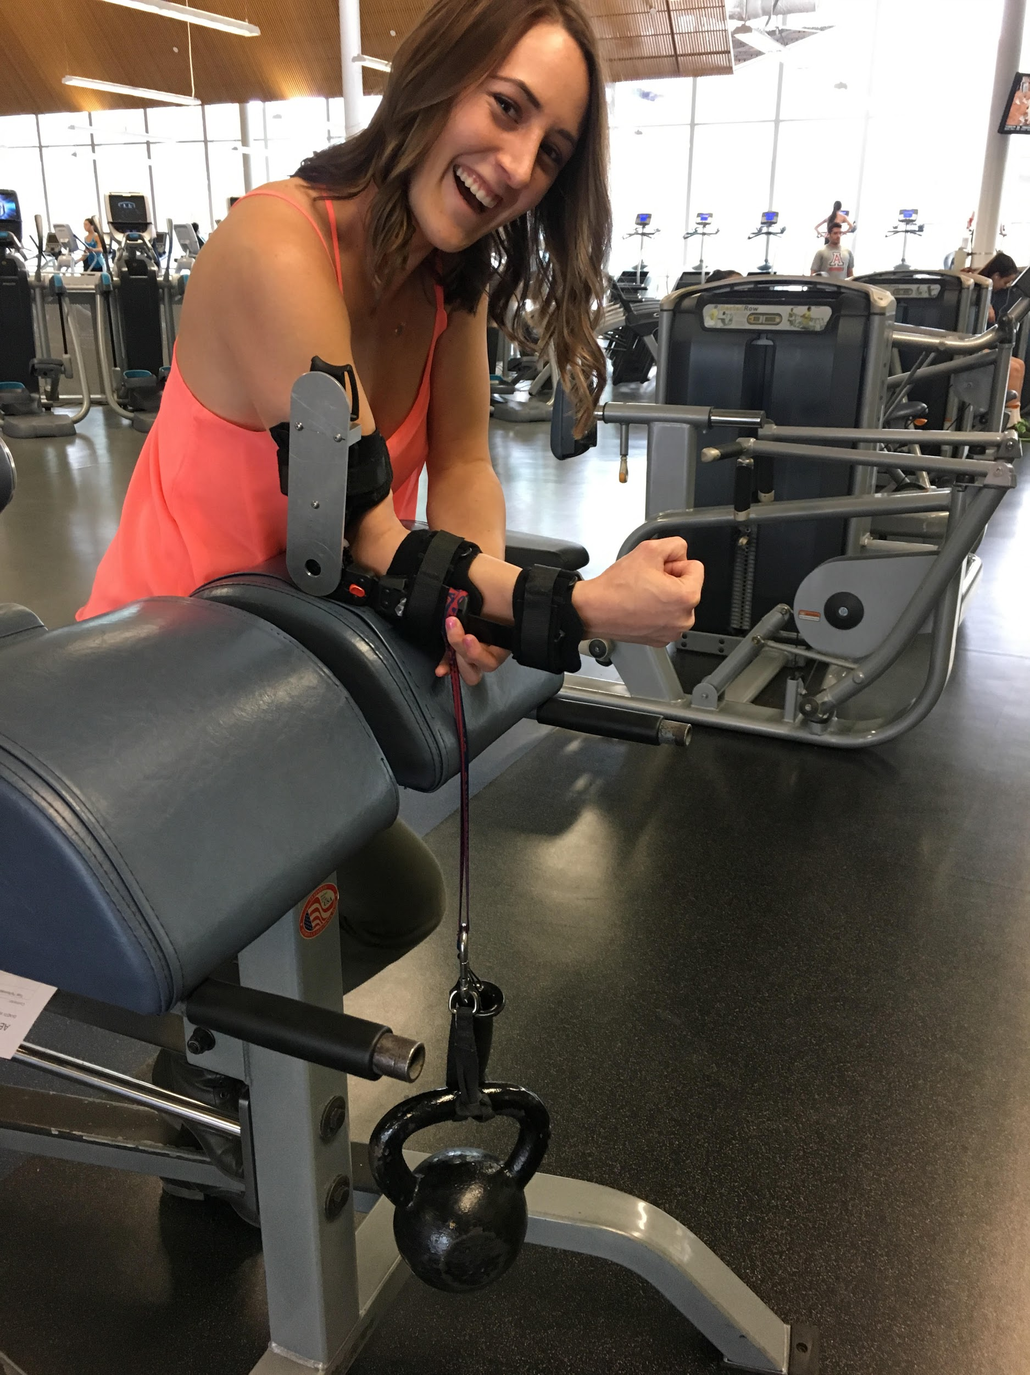
AEO Lock (1.0) Results
DI-NDTI- 80603-T1
Date:__4/1/17________
Contractor:______________________
Pass, or why failed: ____PASS_____________________
Requirements:
The brace shall withstand a 30 lb weight suspension for 15 seconds
The weight shall be hung 6 in from the hinge
Recorded Values:
Distance weight is suspended from hinge (in): __6.0 in____
Duration of suspension (s): Test 1: 18s; Test 2: 15s__
Test Errors: Weight location: +/- 0.2 inches; Weight: +/- 1 lb
Limit Calculation: None
Expected Results: The lock will withstand a 30 lb weight suspension for 15 seconds.

Slide 7
Customer Deliverables
The following is a list of items deliverable to our customer:
Item Title/Description Format When Promised
Drawing Set PDF 5/1/2017
AEO Solidworks Model SLDPRT/SLDASM 5/1/2017
AEO Prototype (1) n/a 5/1/2017
AEO Test Procedure .doc 5/1/2017
AEO Test Report .doc 5/1/2017
AEO iOS Application .ipa 5/1/2017
AEO Arduino Software .ino 5/1/2017

Slide 8
Close Out Plans
The following is a list of items that need to be completed to finish the project:
Item: Deadline:
Motor Torque (2.0) 4/22/2017
Position Tolerance (3.0) 4/22/2017
AEO Sensor (4.0) 4/22/2017
Angular Velocity (5.0) 4/22/2017
Sensor App Accuracy (6.0) 4/22/2017
Temperature Range (7.0) 4/22/2017
Weather (8.0) 4/22/2017
Battery Life (9.0) 4/22/2017
Battery Recharge (10.0) 4/22/2017
Print Second Iteration of Case 4/24/2017
Print Poster 4/24/2017
Assemble Second Case to Device 4/27/2017
Present at Design Day 5/1/2017
Give Customer Deliverables to Sponsor 5/1/2017
Final Report 5/4/2017

Slide 9
Budget
Item | Cost Ea. | Qty. | Supplier | Lead Time | When Needed
Arduino | $36.95 | 1 | Arduino LCC/ Amazon | Obtained | N/A
Potentiometers | $8.13 | 5 pc. | Amazon | Obtained | N/A
Stepper Motor (including gear box) | $50.92 | 1 | StepperOnline Motors and Electronics | Obtained | N/A
Arduino Battery | $17.95 | 1 | Amazon | Obtained | N/A
Motor Battery and converter | $36.97 | 1 | Amazon | Obtained | N/A
Brace | Free | 1 | Sponsor | Obtained | N/A
Stepper Motor Driver | $34.69 | 1 | StepperOnline Motors and Electronics | Obtained | N/A
Slipper Clutch | $102.70 | 1 | Dynatect | Obtained | N/A
Boston Gear Spiral Bevel Gear | $33.51 | 1 | Amazon | Obtained | N/A
Boston Gear Spiral Bevel Pinion Gear | $21.80 | 1 | Amazon | Obtained | N/A
Petg Casing | $80 | 1 | US Plastic | Obtained | N/A
Velcro tape | $9.99 | 1 | ACE Hardware | Obtained | N/A
Hinge and screws | $7.29 | 6 pc. | ACE Hardware | Obtained | N/A

Slide 10
Budget continued...
Item | Cost Ea. | Qty. | Supplier | Lead Time | When Needed
Motor Mounting Bracket | $17.44 | 2 | StepperOnline and Electronics | Obtained | N/A
2 Steel Shafts | $42.87 | 1 | McMaster | Obtained | N/A
Ball Bearing | $15.10 | 2 | McMaster | Obtained | N/A
Small Ball Bearing | $5.77 | 1 | McMaster | Obtained | N/A
Bushing Bearing | $1.26 | 1 | McMaster | Obtained | N/A
Gearbox: aluminum material | $20.45 | 1 | Industrial Metal Supply Co. | Obtained | N/A
Machine Shop Labor | $500.00 | N/A | University of Arizona Machine Shop | Obtained | N/A
Team Shirts | $18.35 | 7 | Aztec Embroidery | Obtained | N/A
Student Consultant | $1000.00 | 1 | N/A | N/A | N/A
Design Day Poster | $140.00 | 1 | University of Arizona | 1 week | 4/28
Total | $2,465.11
Misc. | ~10%
Extended Cost | $2,711.62

Slide 11
Lessons Learned
Plan for setbacks (use risk management), especially with software
Hold each other to set deadlines
Resourcefulness is the difference between success and failure
Progress often happens in small steps

Slide 12
Summary
Switch to Wi-Fi from bluetooth
Change in material for case, addition of notch and velcro straps
Schedule and deliverables
Continue Assembly and Testing
Present at Design Day

